Slide 1
OBJECT detection in images
Mini Project for Third Year, Computer Science and Technology
Made By
Sr. No. | Name | Roll No.
1. | Shantanu Y. Balse | 1
2. | Aniket R. Bhosale | 2
3. | Prasad M. Chaudhari | 3
Department of Technology, Shivaji University, Kolhapur Date: 12 April, 2019

Slide 2
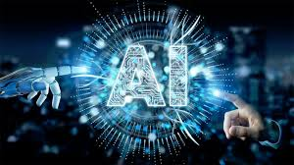
Artificial intelligence :

Slide 3
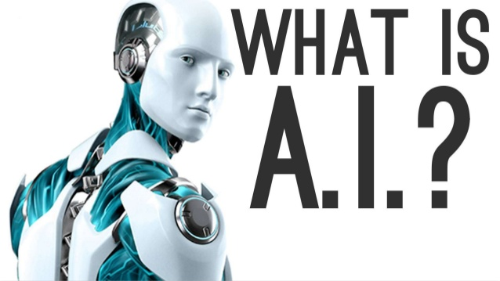

Slide 4
WHAT IS AI :
Using computers to solve problems
Or make automated decisions
For tasks done by humans

Slide 5
Artificial intelligence is a technology that is already impacting how users interact with, and are affected by the Internet.
In future, AI has the potential to vastly change the way that humans interact, not only with digital world, but also with each other, through their work.

Slide 6
Limits of ai :
Strong AI :
Computers thinking at a level that meets or surpasses people
Computers engaging in abstract reasoning and thinking
Weak pattern –based AI :
Computers solve problems by detecting useful patterns
Pattern based AI is an extremely powerful tool
Has been used to automate many processes

Slide 7
Intelligence: “The capacity to learn and solve the problem”
Artificial Intelligence: Artificial intelligence (AI)is the simulation of human intelligence by machines.
The ability to solve problems
The ability to act rationally
The ability to act like humans

Slide 8
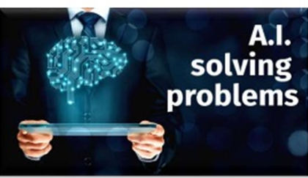
Applications of ai :
. The chances of error are almost nil
. It can be used to explore space, depths of ocean
. Smartphones are greatest example of AI
. It can be used in time consuming takes efficiently
. Machines do not require break they work without stopping

Slide 9
Computer vision :
Is an interdisciplinary scientific field that deals with how computers can be made to gain high-level understanding from digital images or videos.
Theory of building artificial systems that obtain information from images
Image data can take many forms like video sequence, depth images,medical scanner, satellite sensors etc.

Slide 10
Computer vision vs human vision
Vision is an amazing feat of natural intelligence
There are about 30,000 visual categories.
Learn 4.5 categories per day-> 18 yrs.
At age 6, child can learn roughly all 30,000
Machine can’t replicate human image recognization they don’t possesess our ability to recognize distorted images.

Slide 11
Advantages of computer vision :
No limitations like humans
Do not need to have device embedded, physically printed, or externally attached to objects targeted for detection.
Image capturing devices are easy to mount, remove, replace or upgrade.

Slide 12
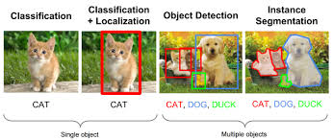
Object detection :
Object detection technology is related to computer vision and image processing
It deals with detecting instances of semantic objects of certain class such as human, cars etc.

Slide 13
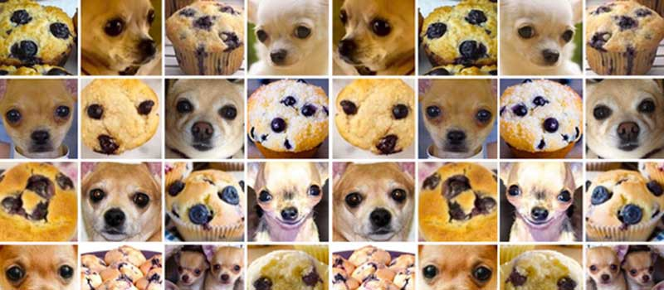
Chihuahua or Muffin?

Slide 14
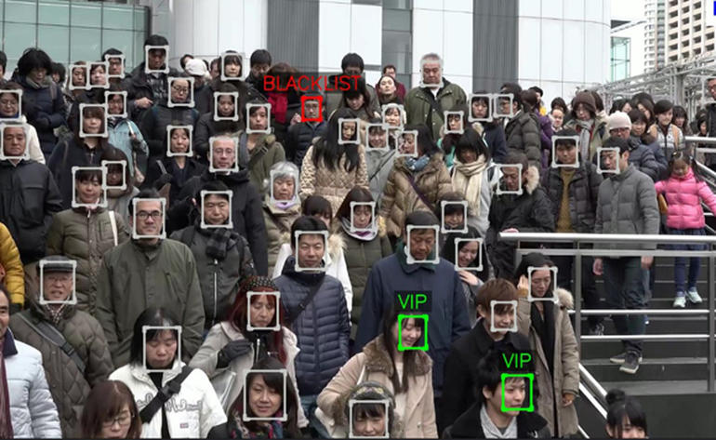
Applications of object detection :
It is useful for Face recognition

Slide 15
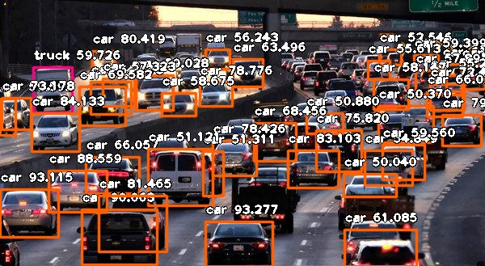
It is also useful in people counting.
Useful in industrial quality check.
Also useful for safe driving cars and security purpose.

Slide 16
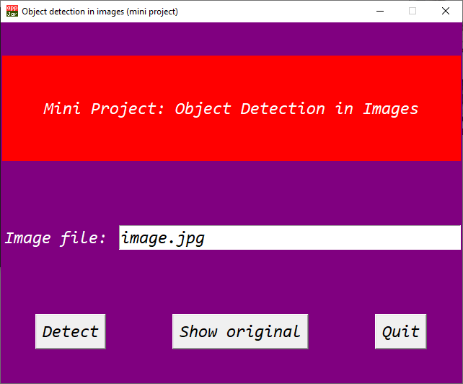
Our Project
Main Window

Slide 17
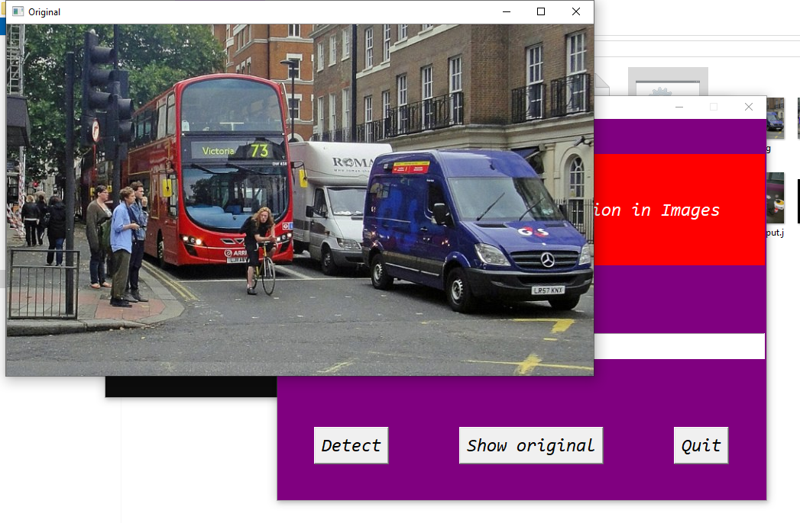
Show original

Slide 18
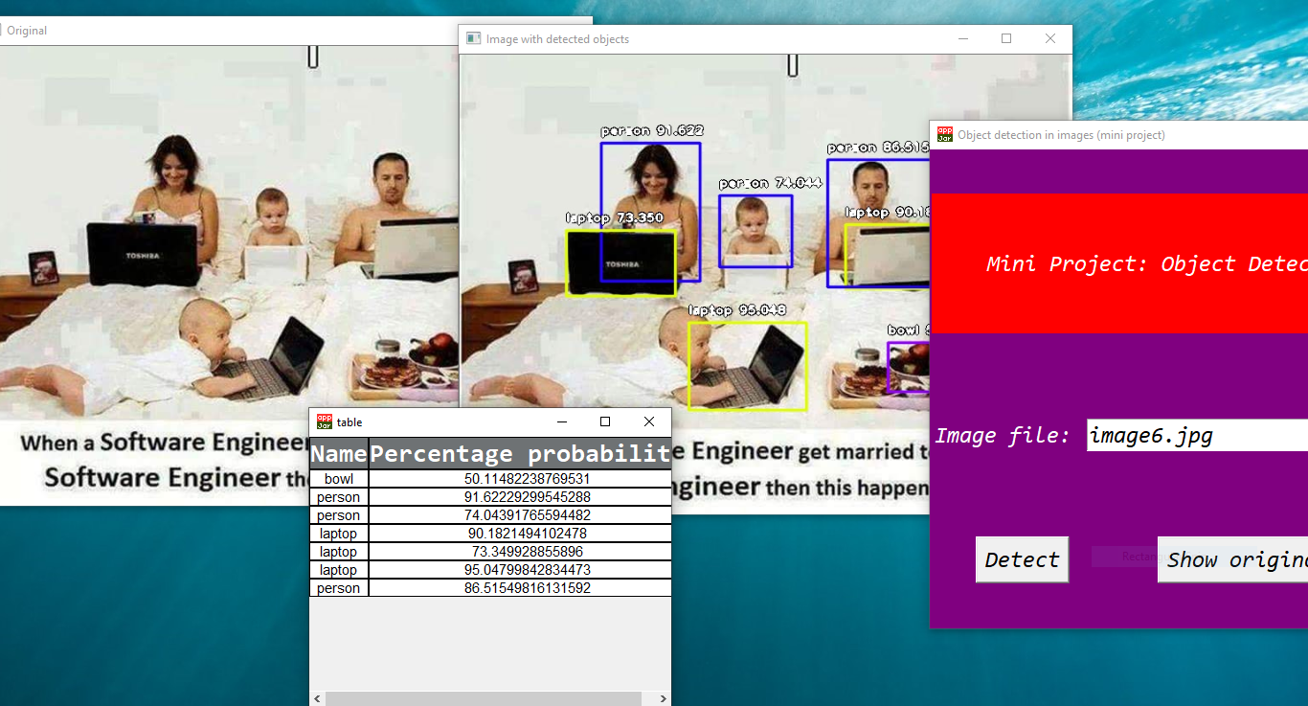
In working

Slide 19
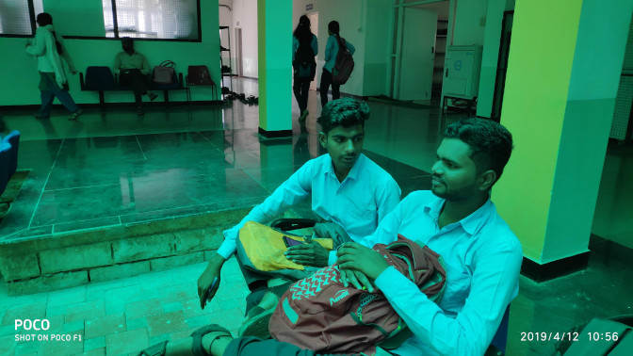
Demonstration: input

Slide 20
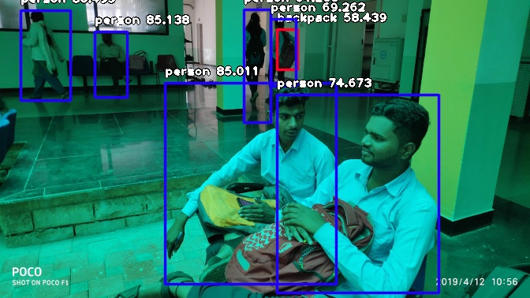
Demonstration: output

Slide 21
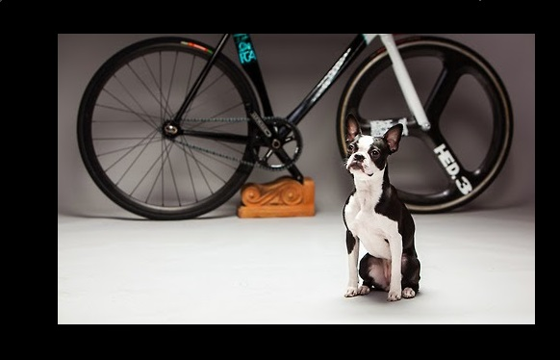
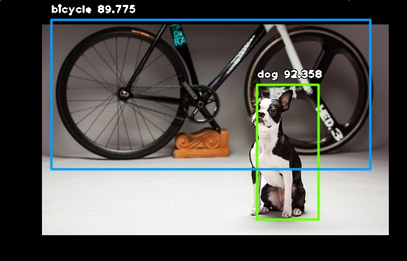
Takes an image file as input and detects all the objects from it

Slide 22
Draws a bounding around each detected object in the image.
Also assigns a label followed by a number.
The label is the type of object that the program has thought it is. Like “dog” and “bicycle”.
The number is the confidence score in percentage. The higher this number is the more accurate is the result.

Slide 23



Implementation details
Written in the Python 3 programming language
Uses the ImageAI framework for object detection
Uses OpenCV for image operations.
Uses the appJar framework work user interface.

Slide 24
Future work
Object detection in videos
Optimization
Real-time object detection

Slide 25
conclusion :
Programs successfully detects various different kinds of objects in image
We were able to successfully incorporate external libraries.
Program performance acceptable
Object detection is progressing field in computer vision
It helps us to gain an insight into this processing field
Pave a way for advanced project in future

